Slide 1
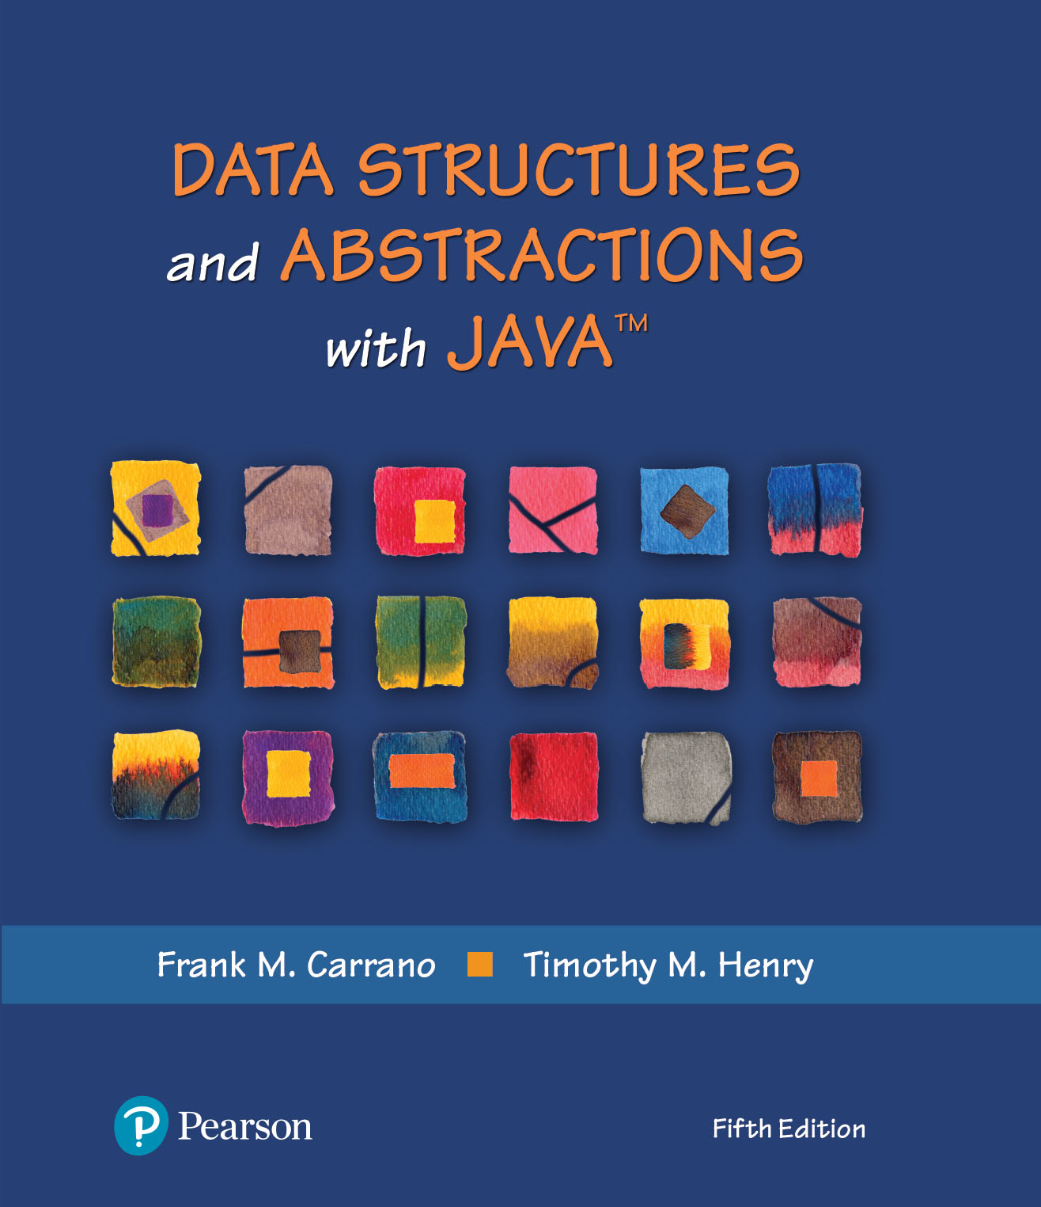
Data Structures and Abstractions with Java™
5th Edition
Chapter 27
A Heap Implementation

Slide 2
Heap and Maxheap
Heap
Complete binary tree whose nodes contain Comparable objects
Maxheap
Object in each node is greater than or equal to the objects in the node’s descendants

Slide 3
Heap and Maxheap
/** An interface for the ADT maxheap. */
public interface MaxHeapInterface<T extends Comparable<? super T>>
{ // See Segment 24.33 for a commented version.
public void add(T newEntry);
public T removeMax();
public T getMax();
public boolean isEmpty();
public int getSize();
public void clear();
} // end MaxHeapInterface
Interface for the ADT Maxheap

Slide 4
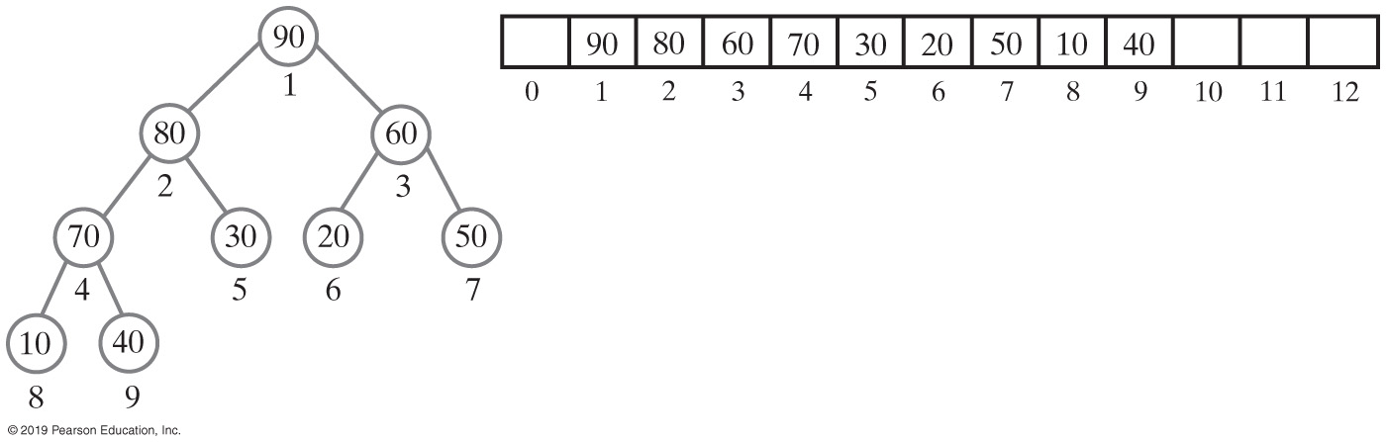
An Array to Represent a Heap
Use an array to represent a complete binary tree
Number nodes in the order in which a level-order traversal would visit them
Can locate either the children or the parent of any node
Perform a simple computation on the node’s number
FIGURE 27-1 A complete binary tree with its nodes numbered in level order and its representation as an array

Slide 5
An Array to Represent a Heap
Start storing the tree at index 1 of the array—that is, skipping the array’s first element—the node at array index i
Has a parent at index i/2, unless the node is the root (i is 1)
Has any children at indices 2i (left child) and 2i + 1 (right child)

Slide 6
An Array to Represent a Heap (Part 1)
/** A class that implements the ADT maxheap by using an array. */
public final class MaxHeap<T extends Comparable<? super T>>
implements MaxHeapInterface<T>
{
private T[] heap; // Array of heap entries; ignore heap[0]
private int lastIndex; // Index of last entry and number of entries
private boolean integrityOK = false;
private static final int DEFAULT_CAPACITY = 25;
private static final int MAX_CAPACITY = 10000;
public MaxHeap(int initialCapacity)
{
// Is initialCapacity too small?
if (initialCapacity < DEFAULT_CAPACITY)
initialCapacity = DEFAULT_CAPACITY;
else // Is initialCapacity too big?
checkCapacity(initialCapacity);
// The cast is safe because the new array contains null entries
@SuppressWarnings("unchecked")
T[] tempHeap = (T[])new Comparable[initialCapacity + 1];
heap = tempHeap;
lastIndex = 0;
integrityOK = true;
} // end constructor
LISTING 27-1 The class MaxHeap, partially completed

Slide 7
An Array to Represent a Heap (Part 2)
public MaxHeap()
{
this(DEFAULT_CAPACITY); // Call next constructor
} // end default constructor
public T getMax()
{
checkIntegrity();
T root = null;
if (!isEmpty())
root = heap[1];
return root;
} // end getMax
public boolean isEmpty()
{
return lastIndex < 1;
} // end isEmpty
public int getSize()
{
return lastIndex;
} // end getSize
LISTING 27-1 The class MaxHeap, partially completed

Slide 8
An Array to Represent a Heap (Part 3)
public void add(T newEntry)
{
// Will address later — See Segment 27.8.
} // end add
public T removeMax()
{
// Will address later — See Segment 27.12.
} // end removeMax
public void clear()
{
checkIntegrity();
while (lastIndex > -1)
{
heap[lastIndex] = null;
lastIndex--;
} // end while
lastIndex = 0;
} // end clear
// Private methods
// . . .
} // end MaxHeap
LISTING 27-1 The class MaxHeap, partially completed

Slide 9
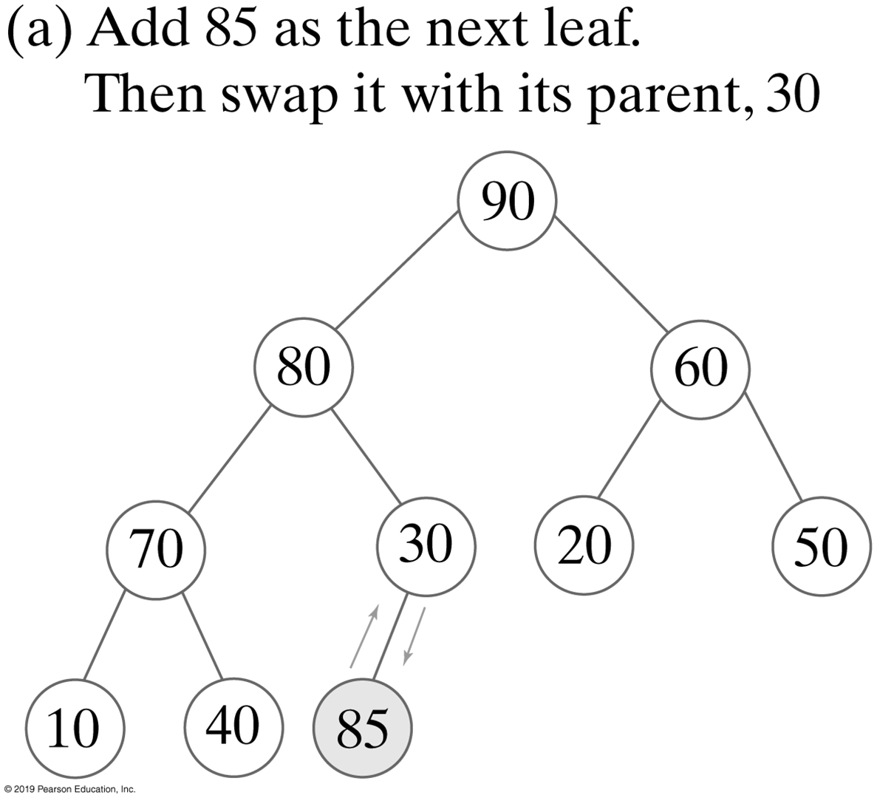
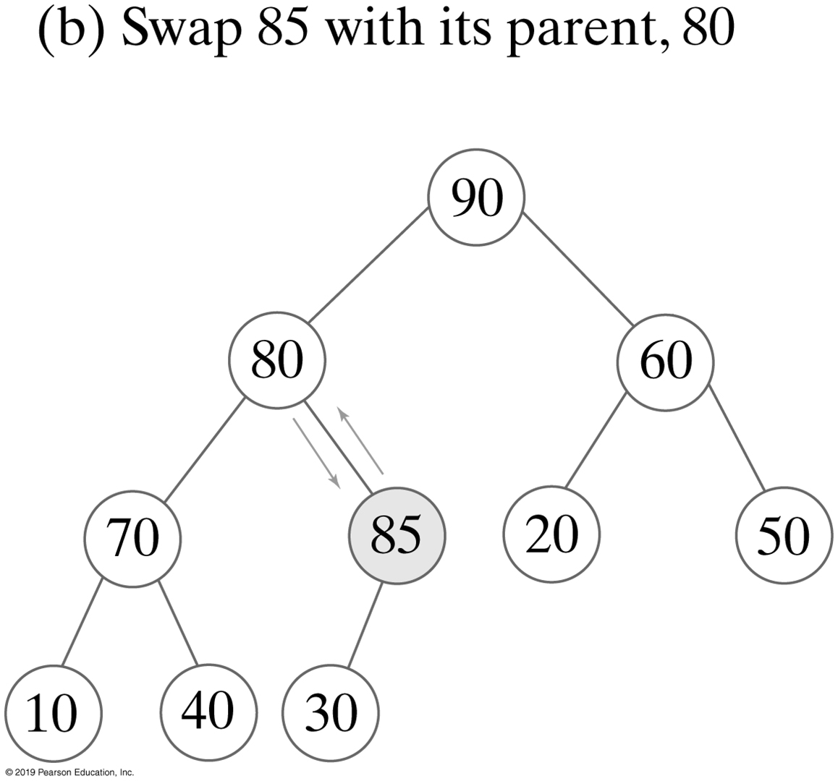
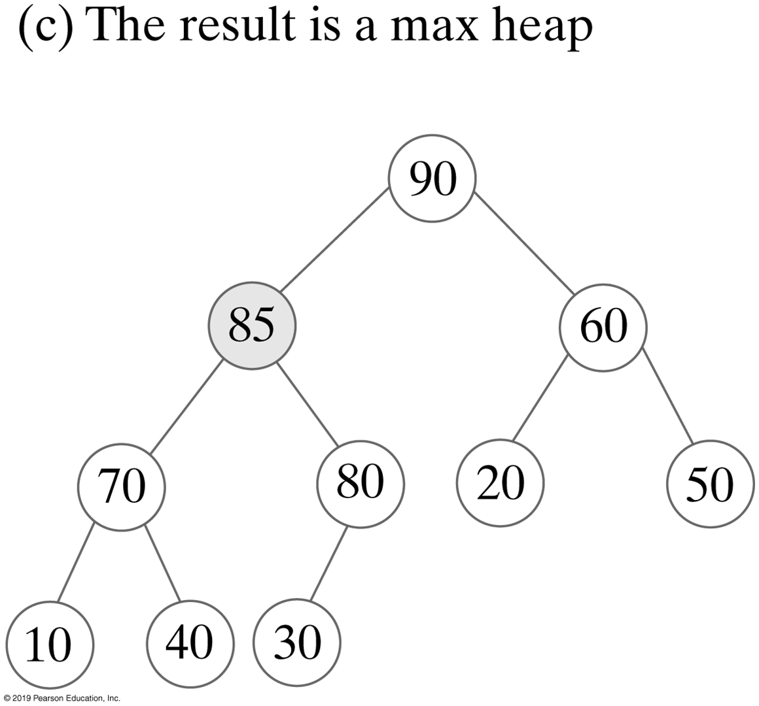
Adding an Entry
FIGURE 27-2 The steps in adding 85 to the maxheap in Figure 27-1a

Slide 10
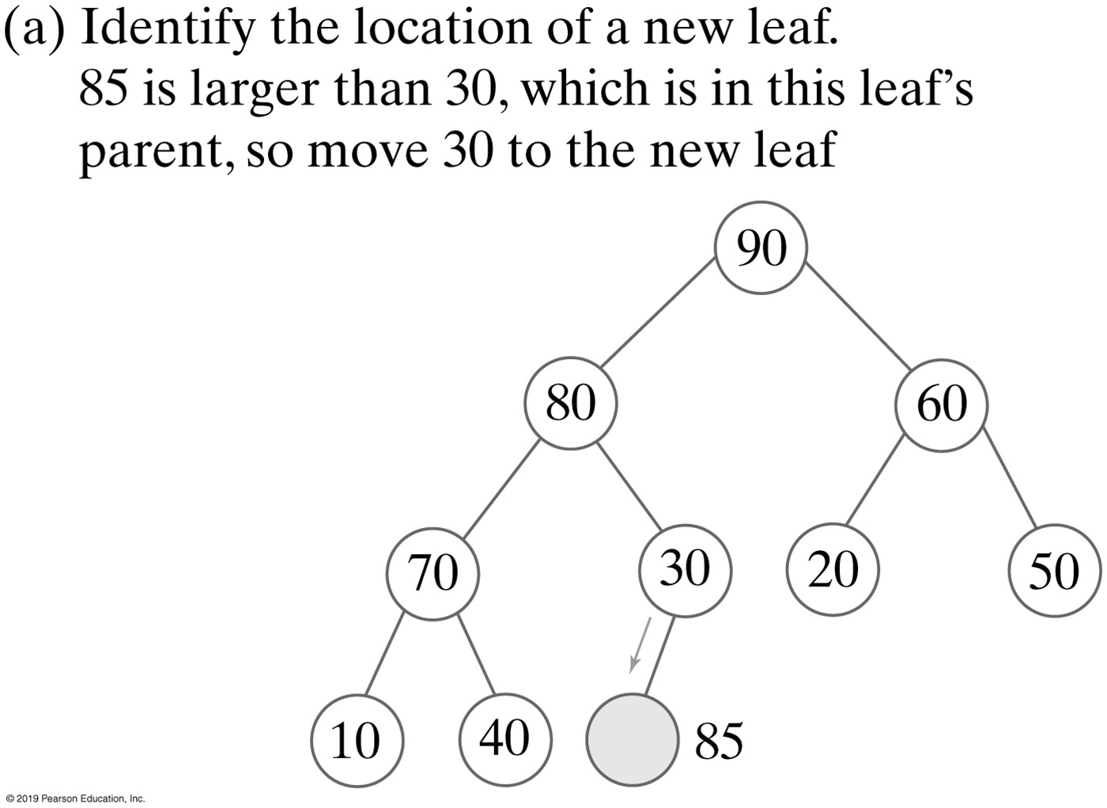
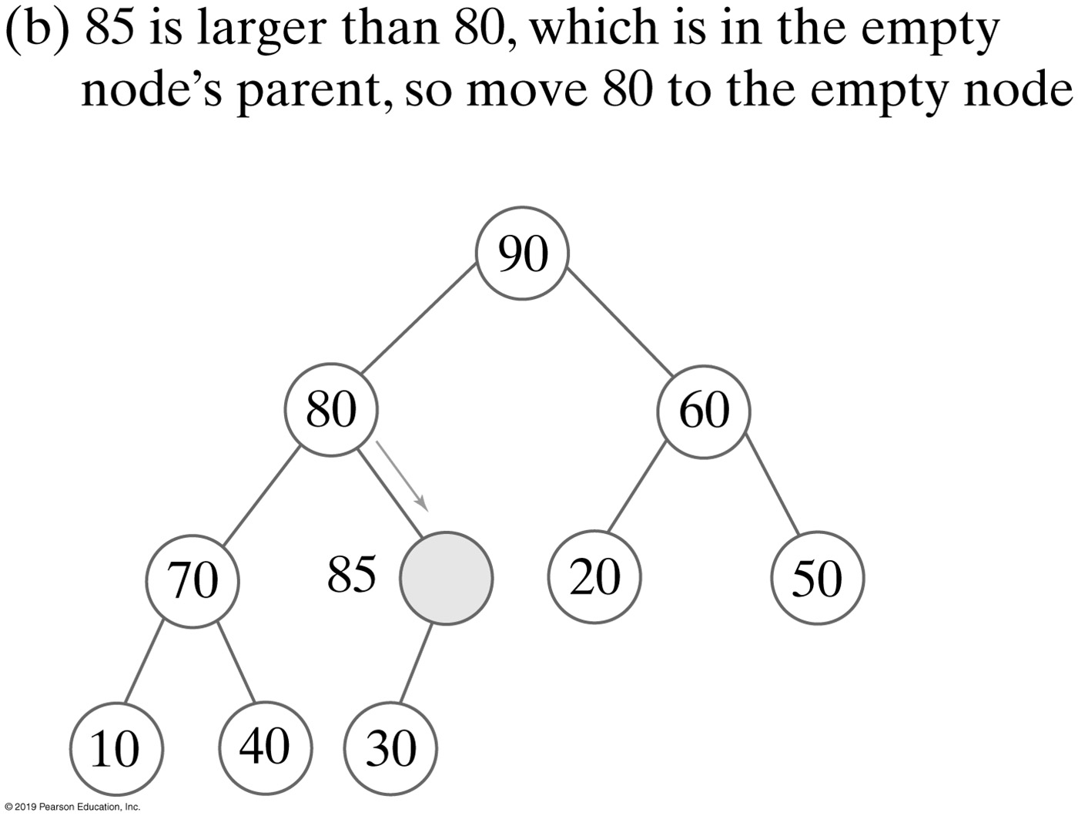
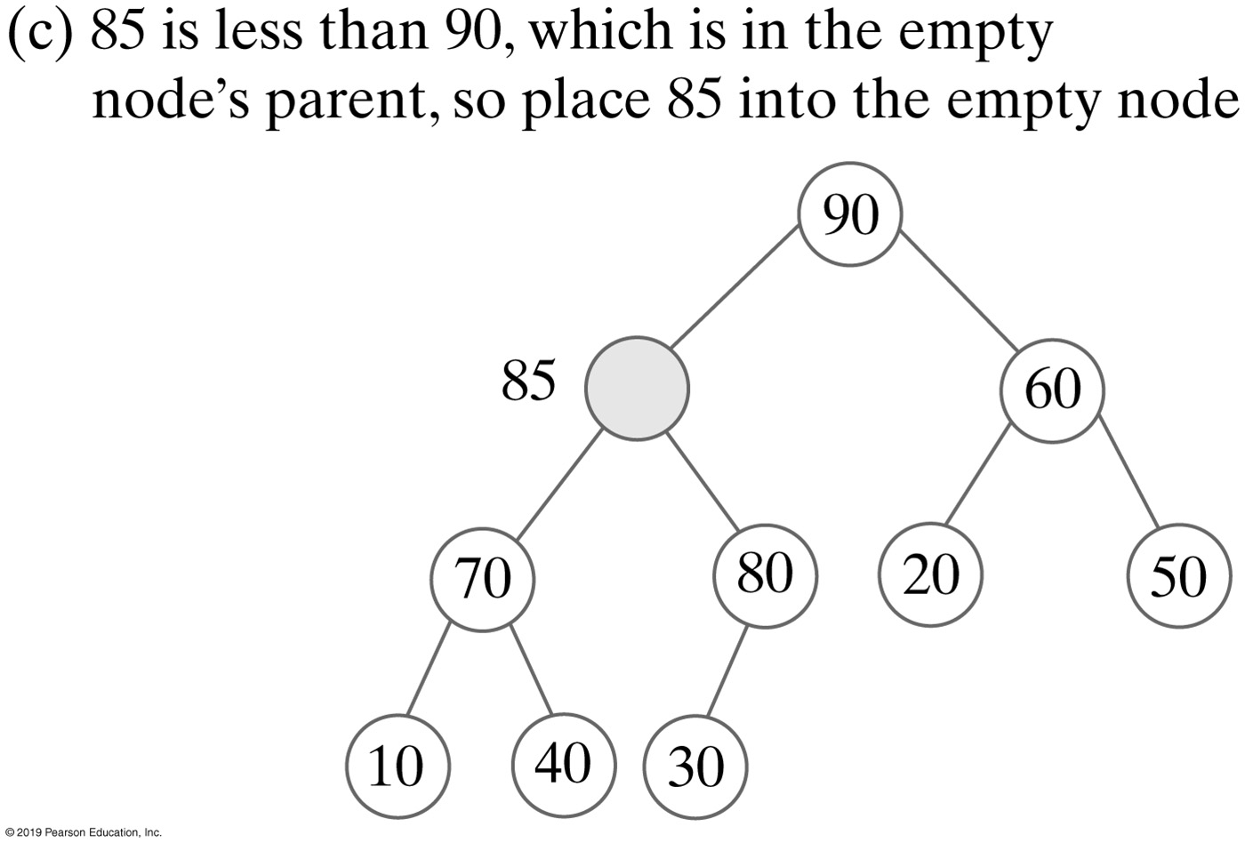
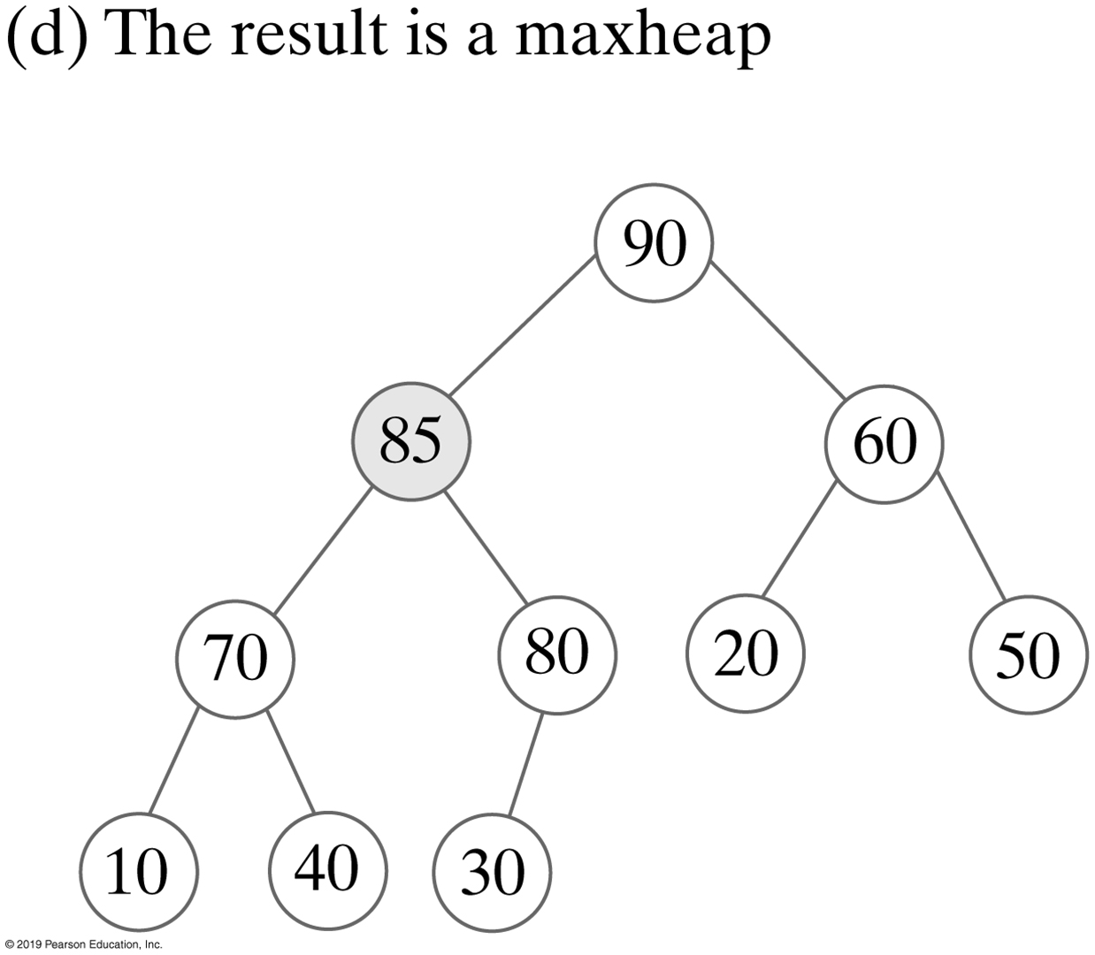
Adding an Entry without Swaps
FIGURE 27-3 A revision of the steps to add 85, as shown in Figure 27-2, to avoid swaps

Slide 11
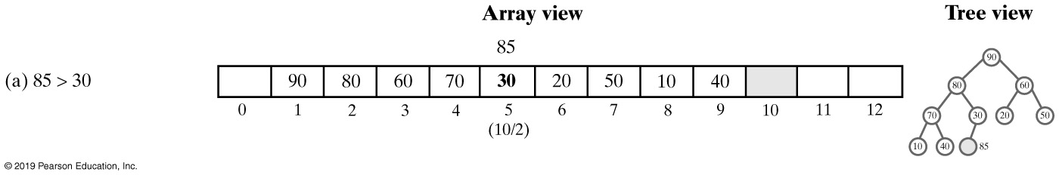
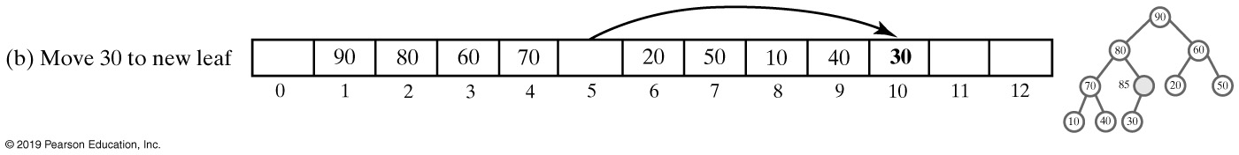
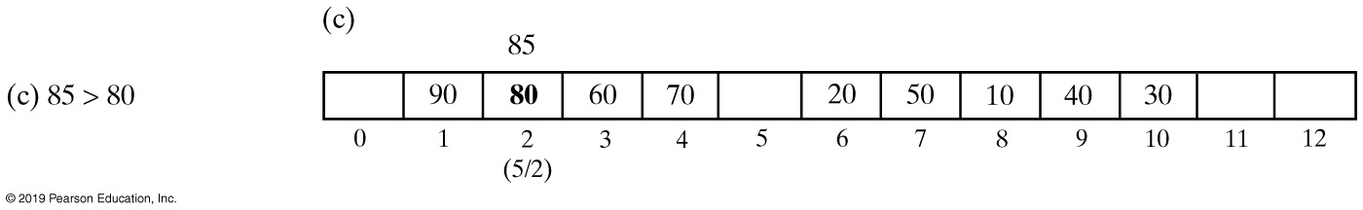
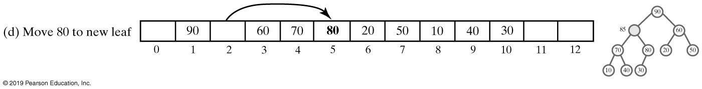
Adding an Entry to Heap (Part 1)
FIGURE 27-4 An array representation of the steps in Figure 27-3

Slide 12
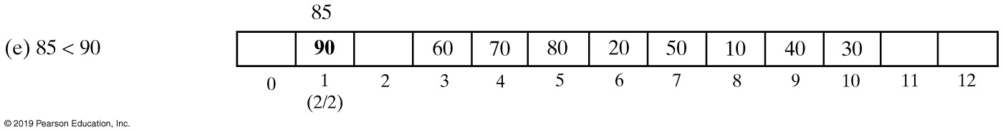
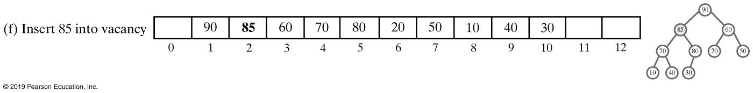
Adding an Entry to Heap (Part 2)
FIGURE 27-4 An array representation of the steps in Figure 27-3

Slide 13
Adding an Entry
Algorithm add(newEntry)
// Precondition: The array heap has room for another entry.
newIndex = index of next available array location
parentIndex = newIndex/2 // Index of parent of available location
while (parentIndex > 0 and newEntry > heap[parentIndex])
{
heap[newIndex] = heap[parentIndex] // Move parent to available location
// Update indices
newIndex = parentIndex parentIndex = newIndex/2
}
heap[newIndex] = newEntry // Place new entry in correct location
if (the array heap is full)
Double the size of the array
Algorithm to add a new entry to a heap

Slide 14
Adding an Entry
public void add(T newEntry)
{
checkIntegrity(); // Ensure initialization of data fields
int newIndex = lastIndex + 1;
int parentIndex = newIndex / 2;
while ( (parentIndex > 0) && newEntry.compareTo(heap[parentIndex]) > 0)
{
heap[newIndex] = heap[parentIndex];
newIndex = parentIndex;
parentIndex = newIndex / 2;
} // end while
heap[newIndex] = newEntry;
lastIndex++;
ensureCapacity();
} // end add
The method add

Slide 15
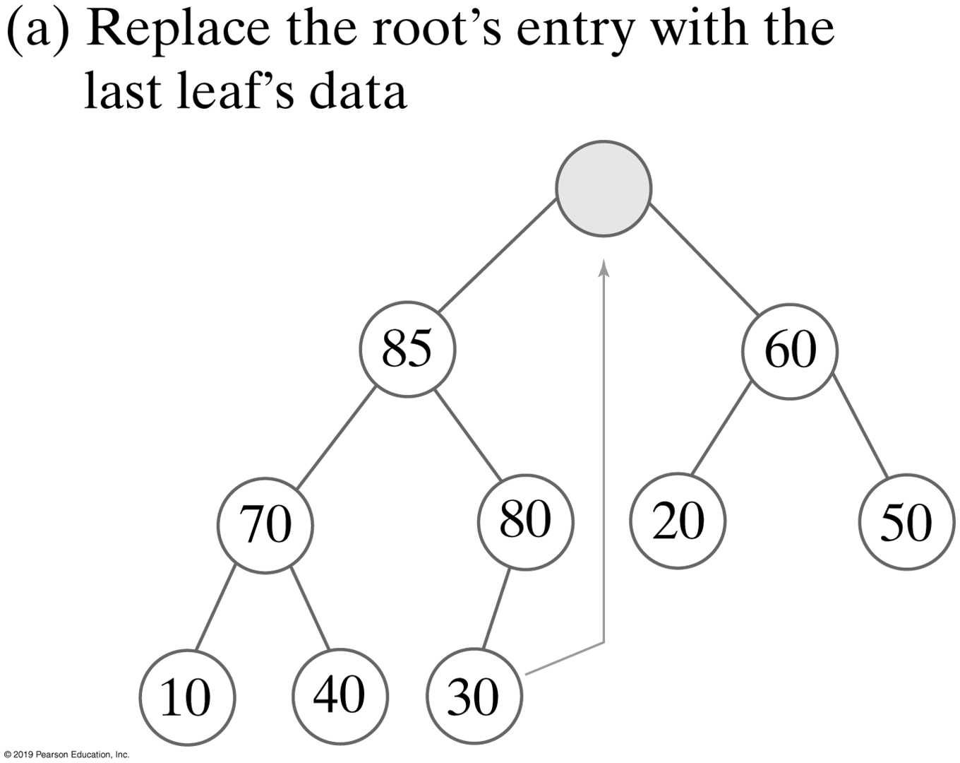
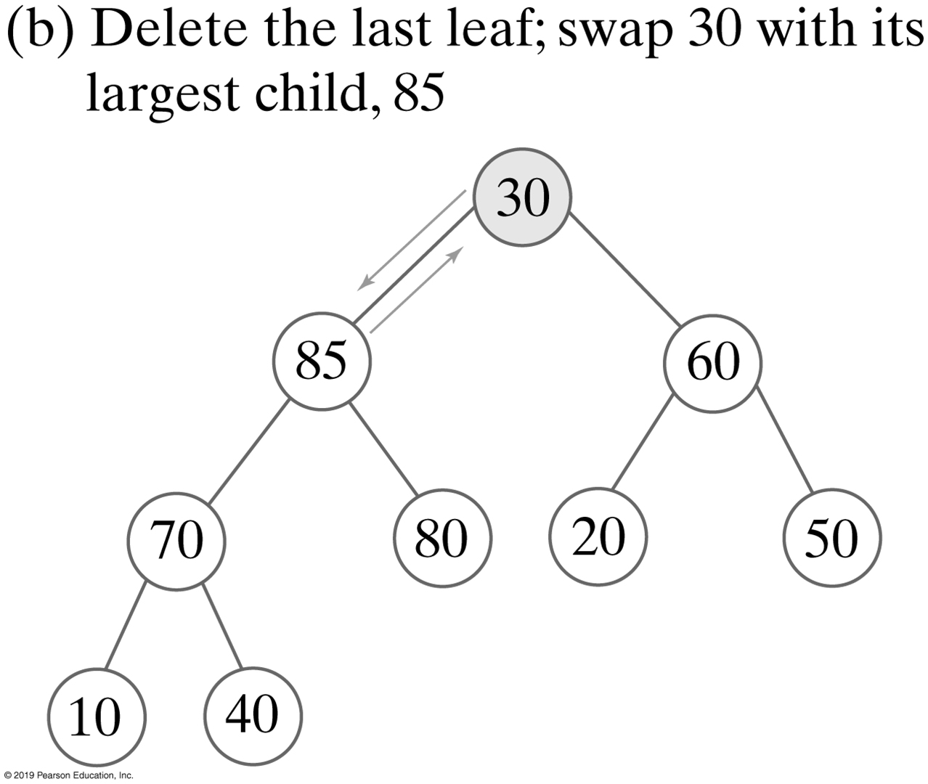
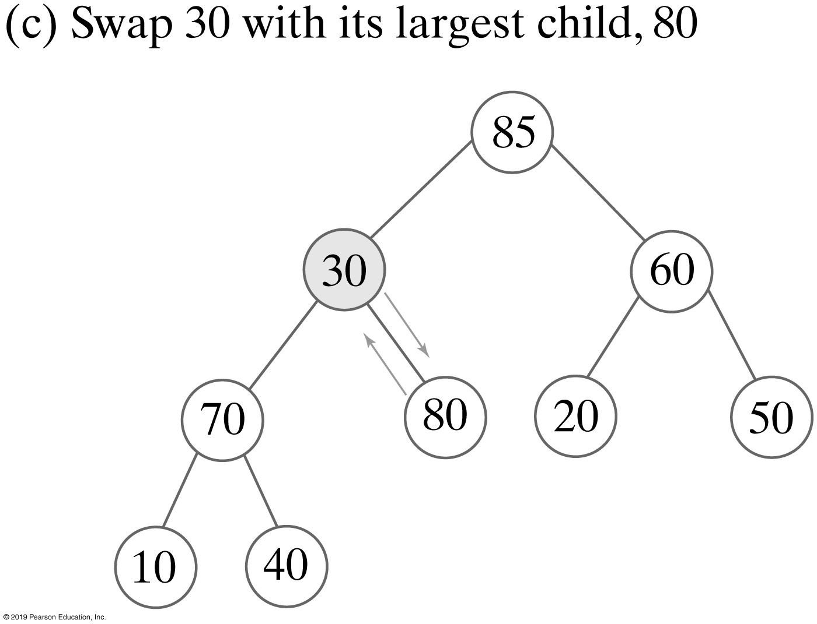
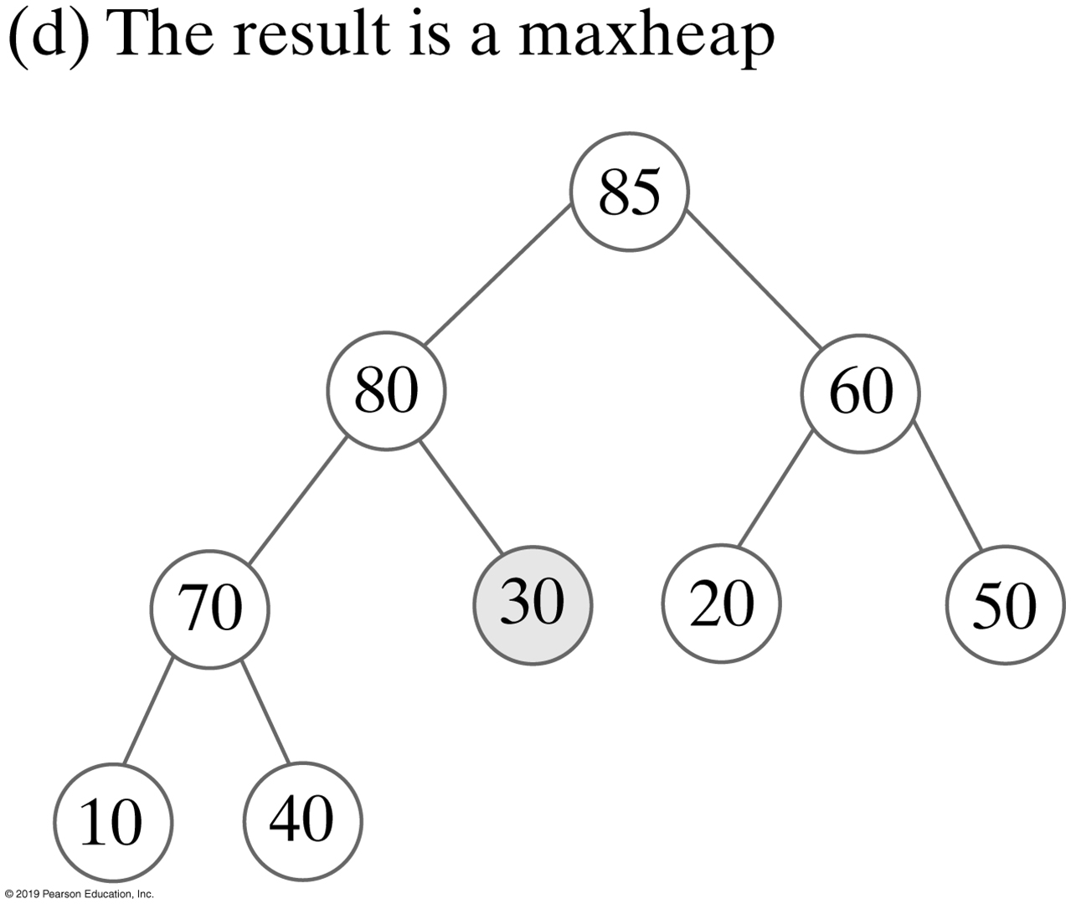
Removing a Value from A Heap
Semiheap
FIGURE 27-5 The steps to remove the entry in the root of the maxheap in Figure 27-3d

Slide 16
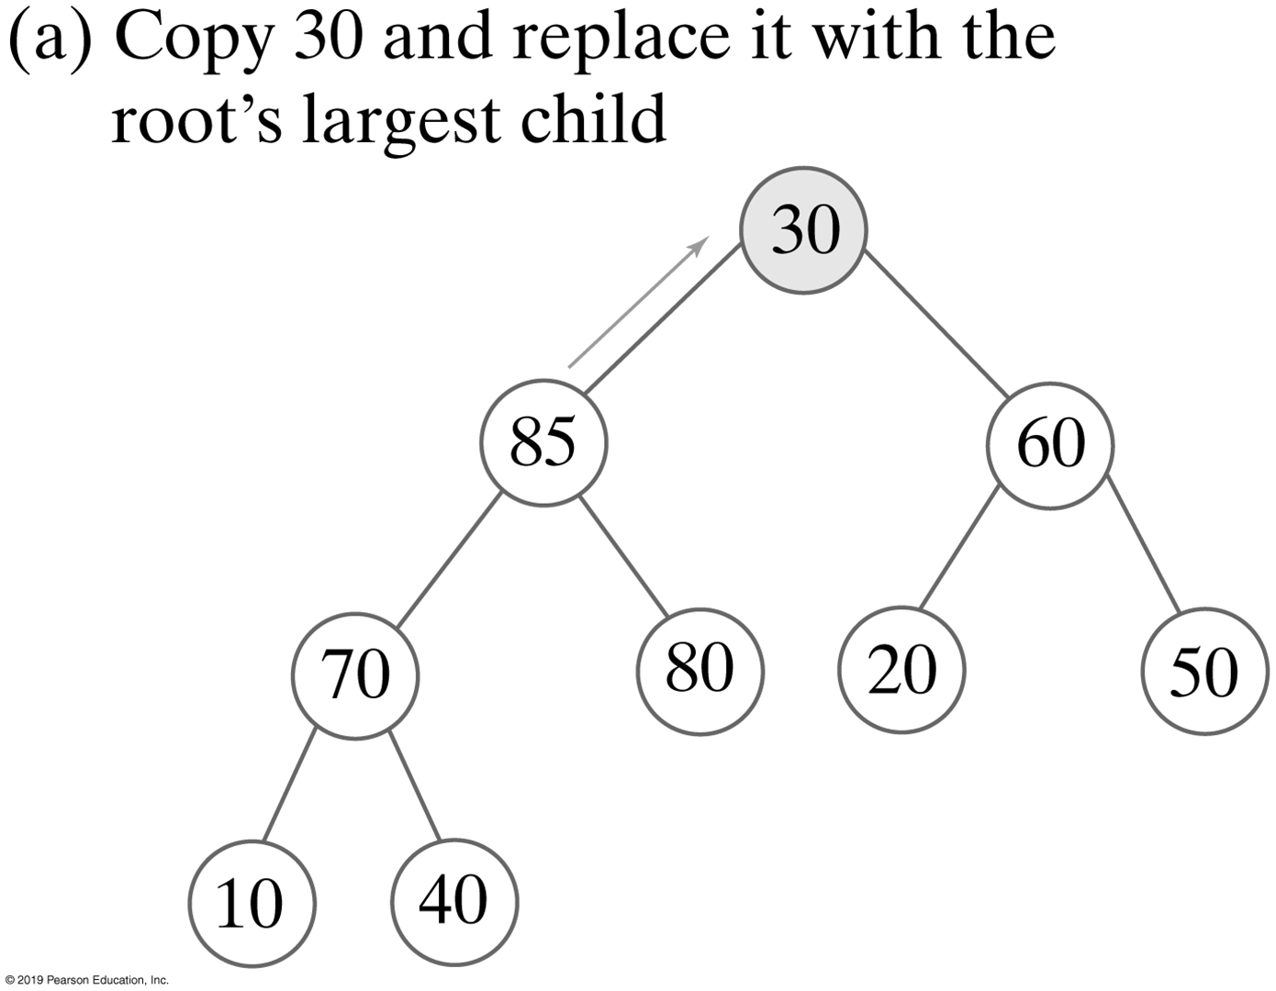
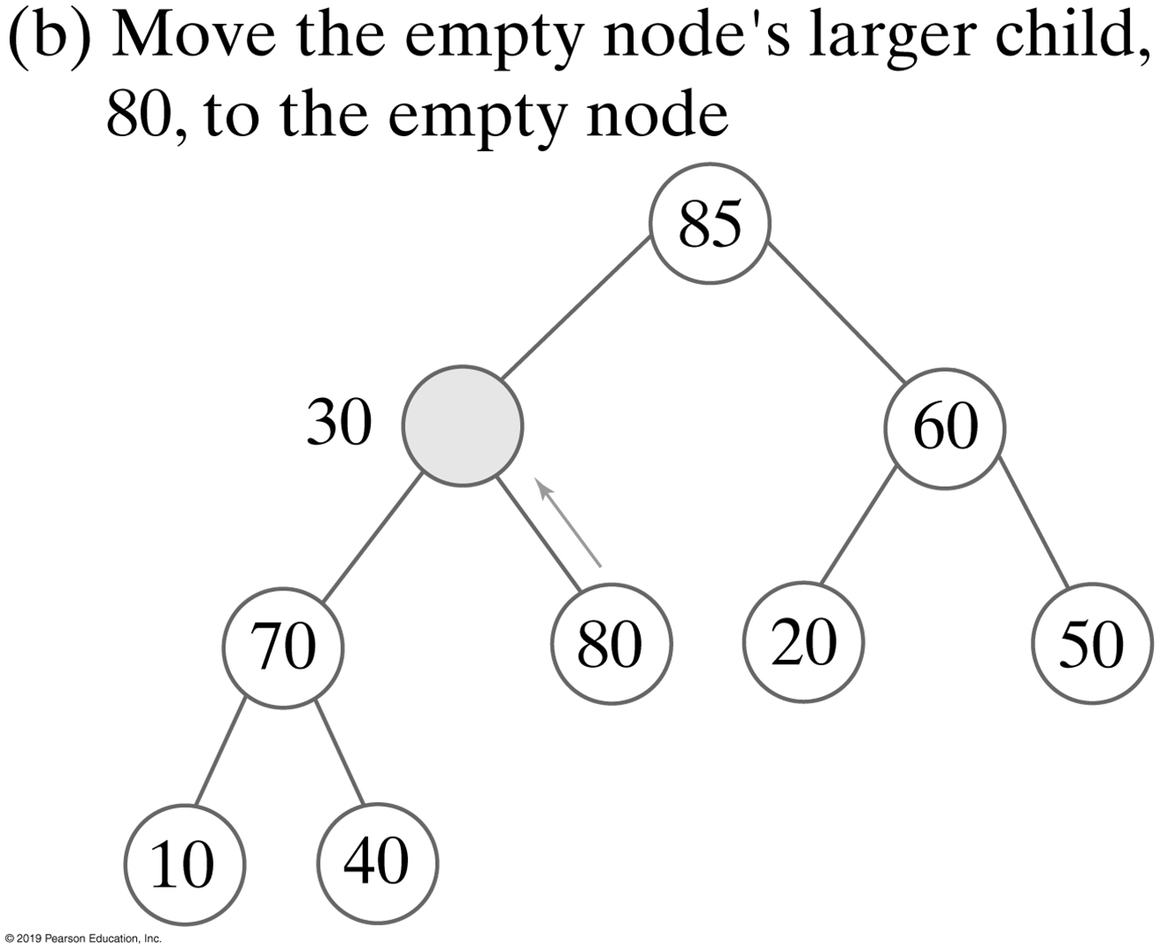
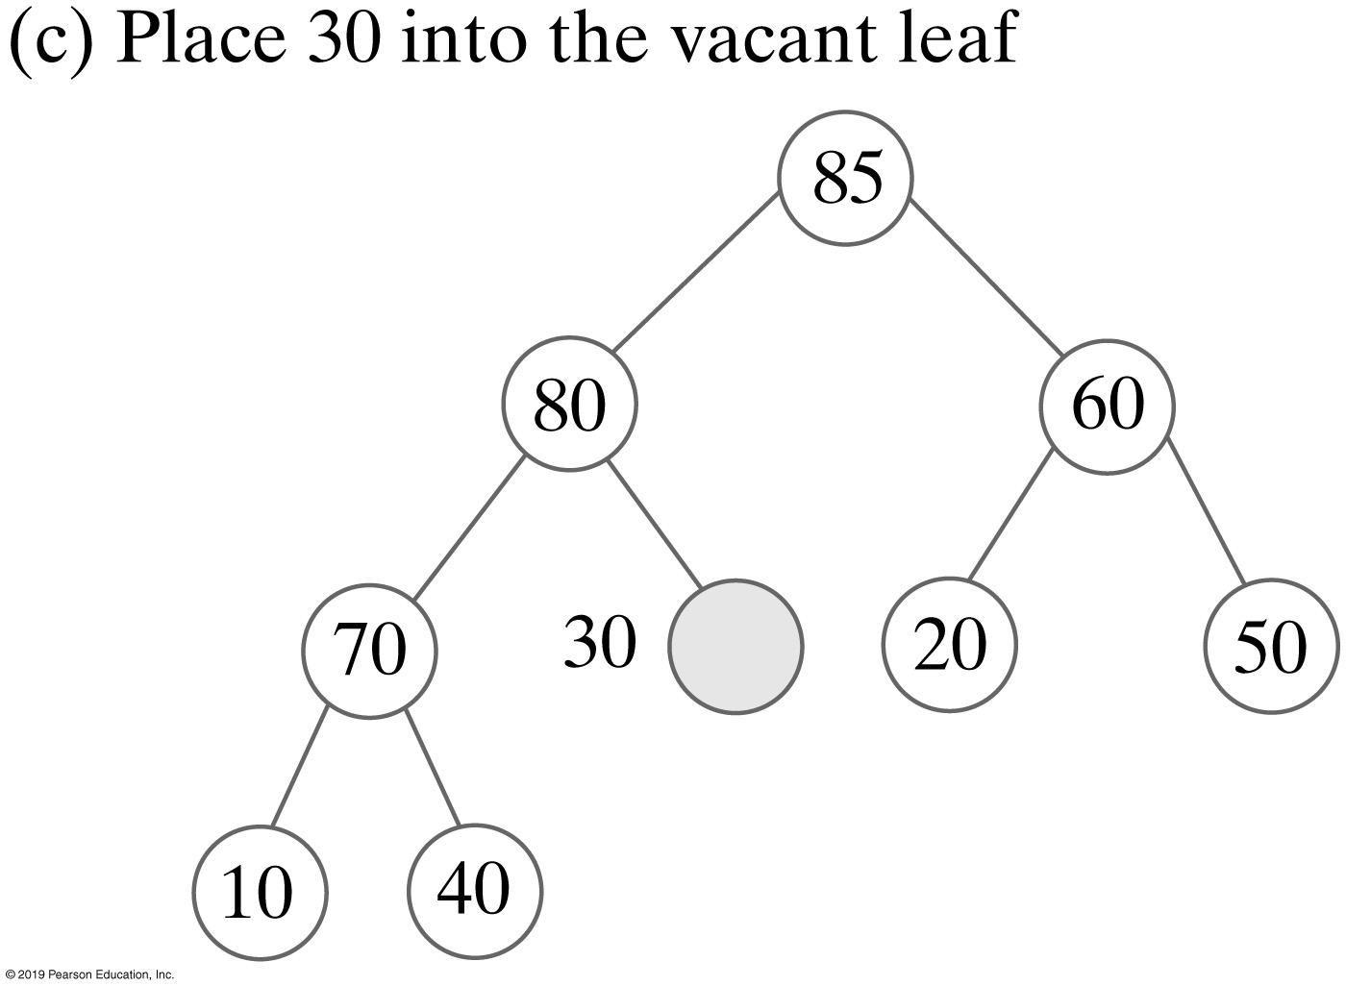
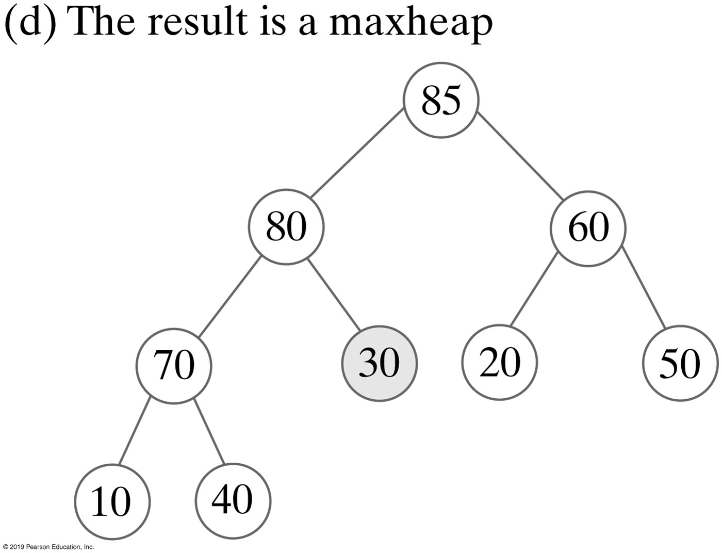
Removing a Value without Swaps
FIGURE 27-6 The steps to transform the semiheap in Figure 27-5b into a heap without using swaps

Slide 17
Removing the Root
Algorithm reheap(rootIndex)
// Transforms the semiheap rooted at rootIndex into a heap
done = false
orphan = heap[rootIndex]
while (!done and heap[rootIndex] has a child)
{
largerChildIndex = index of the larger child of heap[rootIndex]
if (orphan < heap[largerChildIndex])
{
heap[rootIndex] = heap[largerChildIndex]
rootIndex = largerChildIndex
}
else
done = true
}
heap[rootIndex] = orphan
Algorithm to transform a semiheap to a heap

Slide 18
Removing the Root
private void reheap(int rootIndex)
{
boolean done = false;
T orphan = heap[rootIndex];
int leftChildIndex = 2 * rootIndex;
while (!done && (leftChildIndex <= lastIndex) )
{
int largerChildIndex = leftChildIndex; // Assume larger
int rightChildIndex = leftChildIndex + 1;
if ( (rightChildIndex <= lastIndex) &&
heap[rightChildIndex].compareTo(heap[largerChildIndex]) > 0)
{
largerChildIndex = rightChildIndex;
} // end if
if (orphan.compareTo(heap[largerChildIndex]) < 0)
{
heap[rootIndex] = heap[largerChildIndex];
rootIndex = largerChildIndex;
leftChildIndex = 2 * rootIndex;
}
else
done = true;
} // end while
heap[rootIndex] = orphan;
} // end reheap
Height of a complete n-node tree is log₂(n+1)
Reheap is O(log n) operation
Implementation of the reheap algorithm as a private method

Slide 19
Removing the Root
public T removeMax()
{
checkIntegrity(); // Ensure initialization of data fields
T root = null;
if (!isEmpty())
{
root = heap[1]; // Return value
heap[1] = heap[lastIndex]; // Form a semiheap
lastIndex--; // Decrease size
reheap(1); // Transform to a heap
} // end if
return root;
} // end removeMax
Implementation of the removeMax method

Slide 20
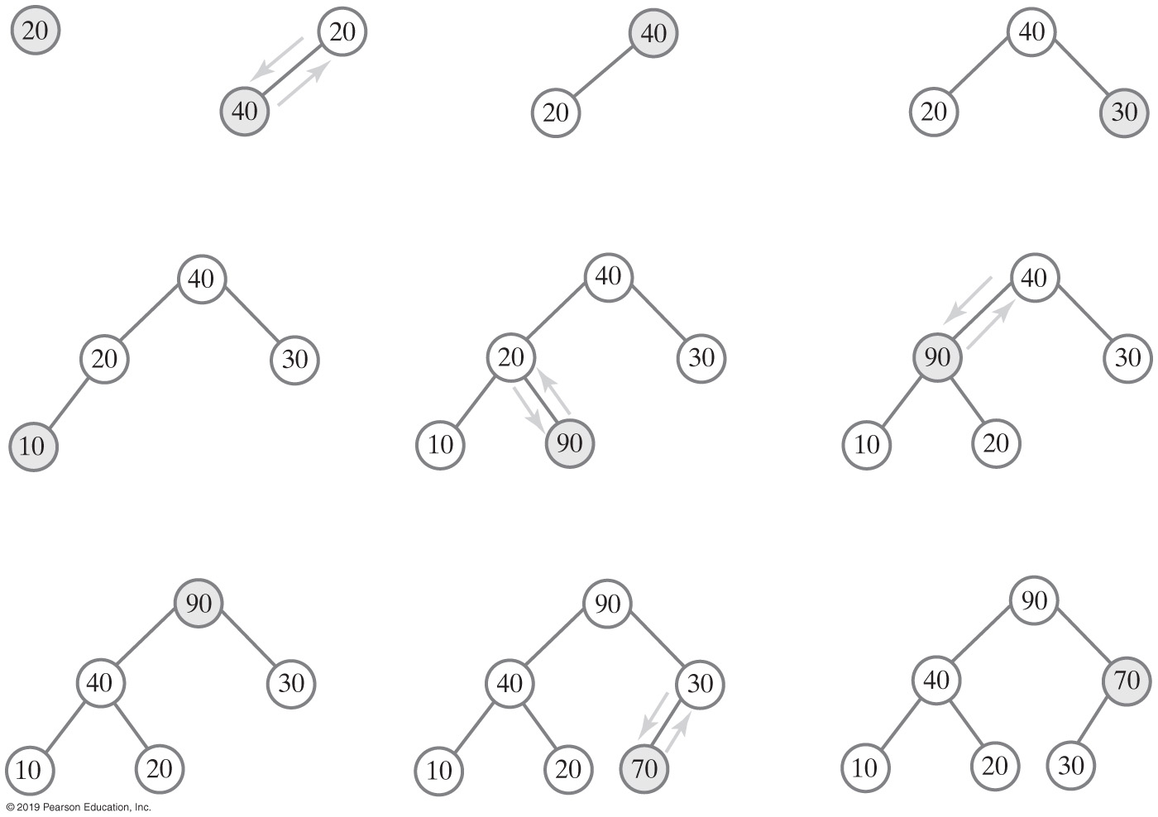
Creating a Heap
O(n log n)
FIGURE 27-7 The steps in adding 20, 40, 30, 10, 90, and 70 to an initially empty heap using add method

Slide 21
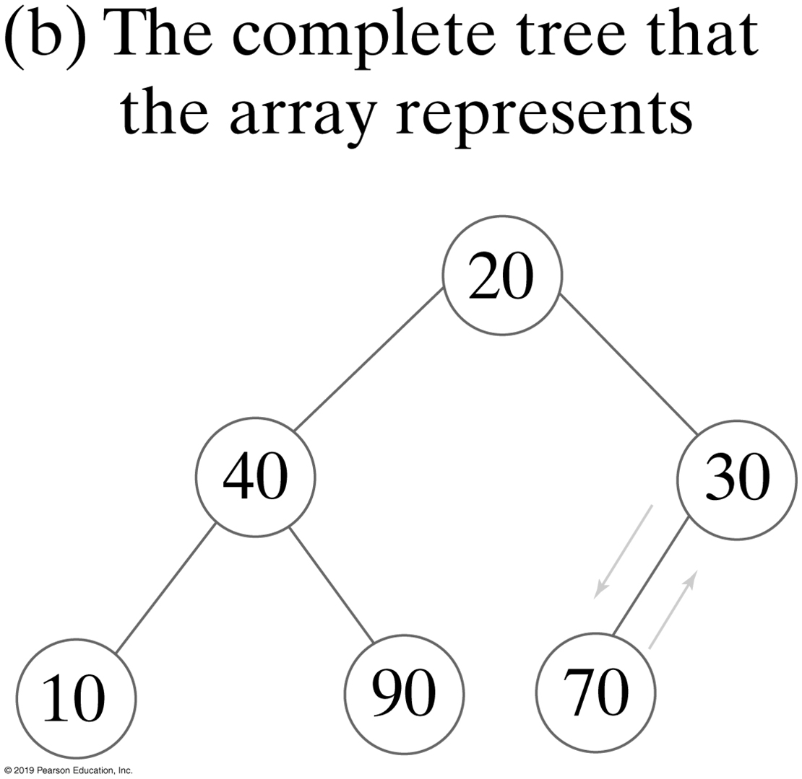
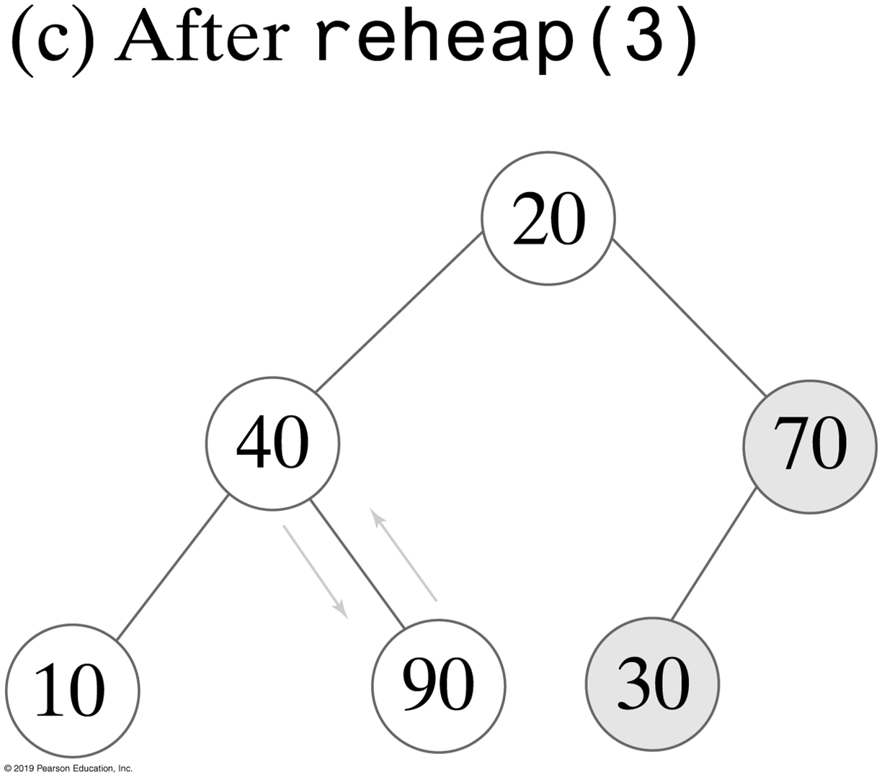
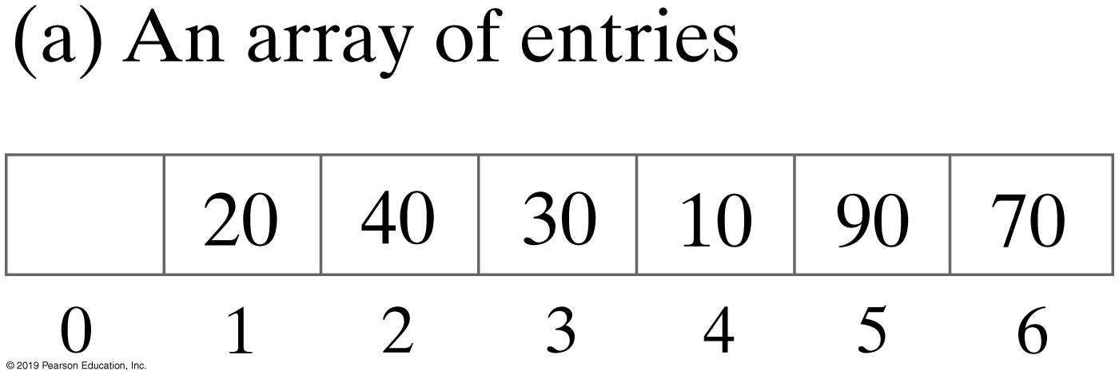
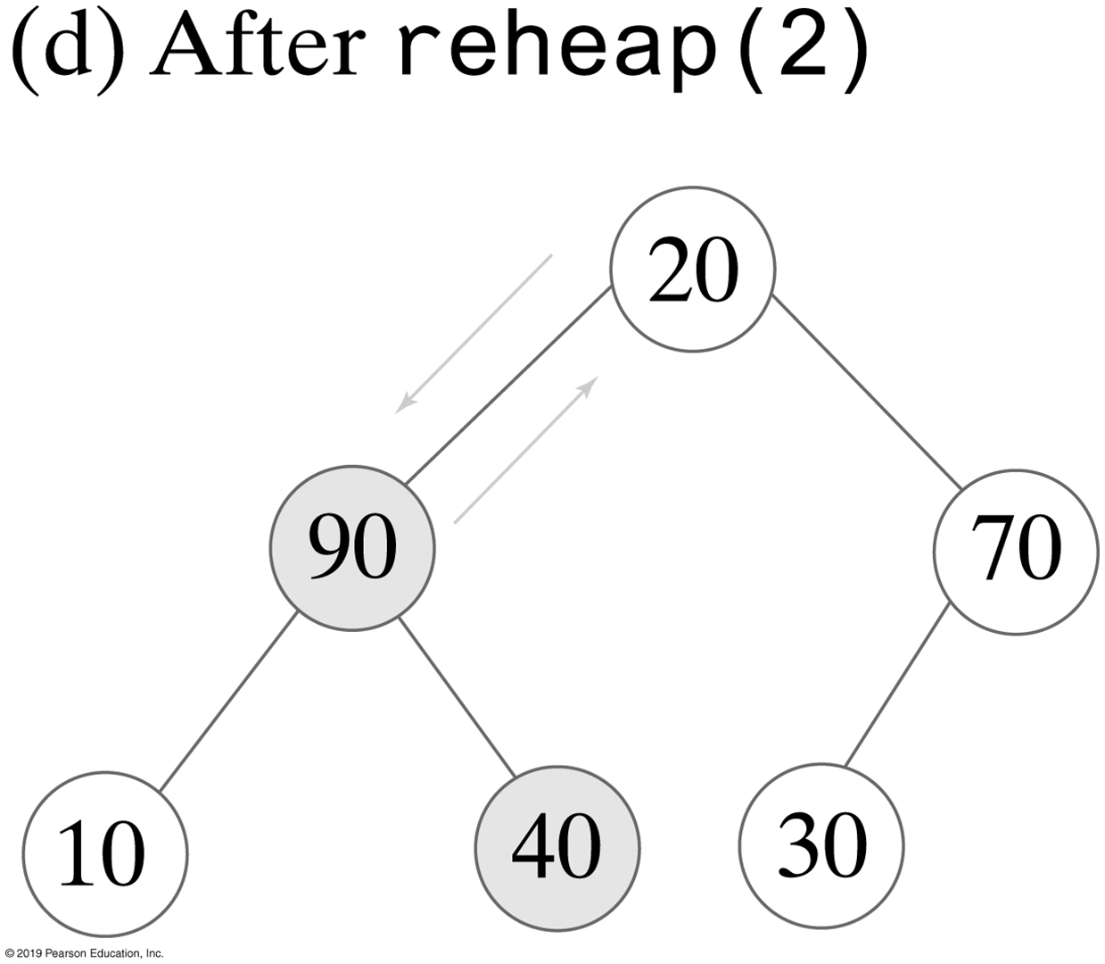
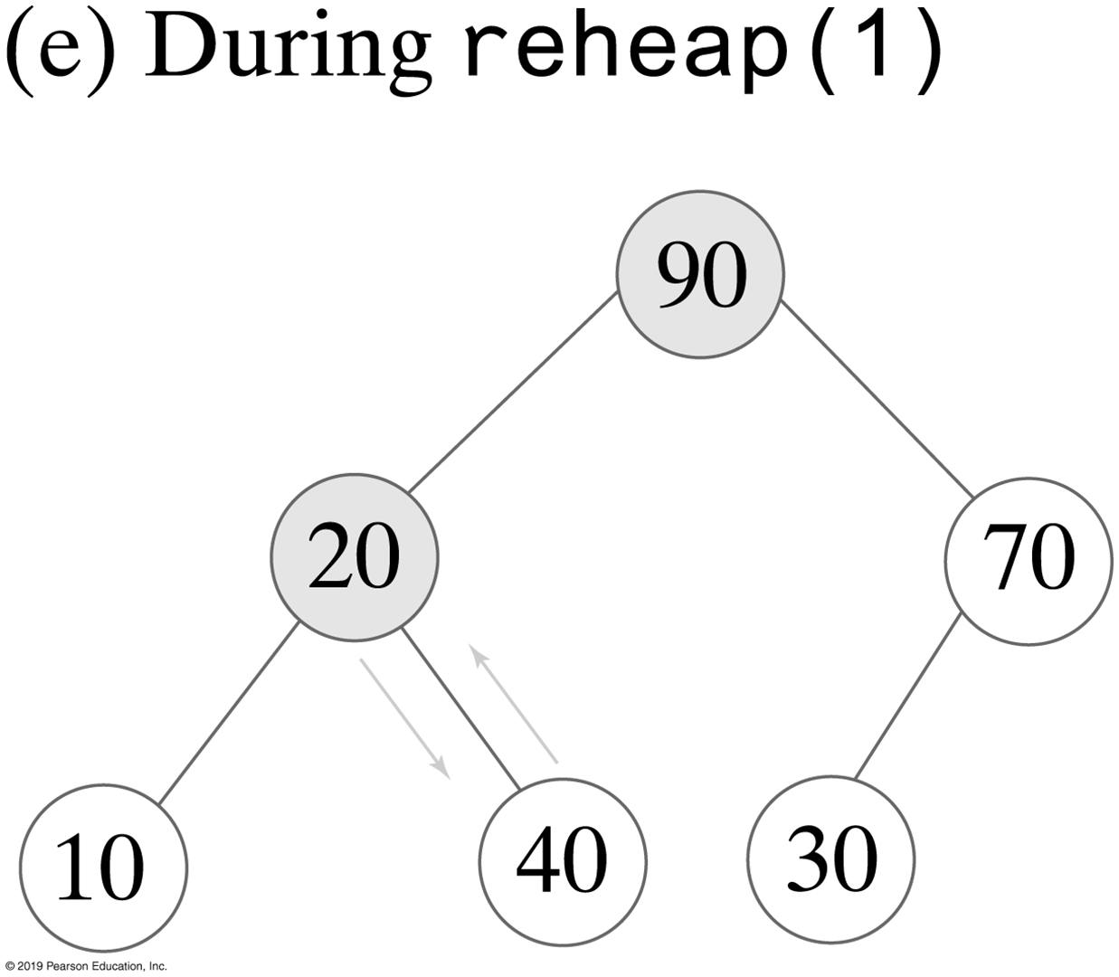
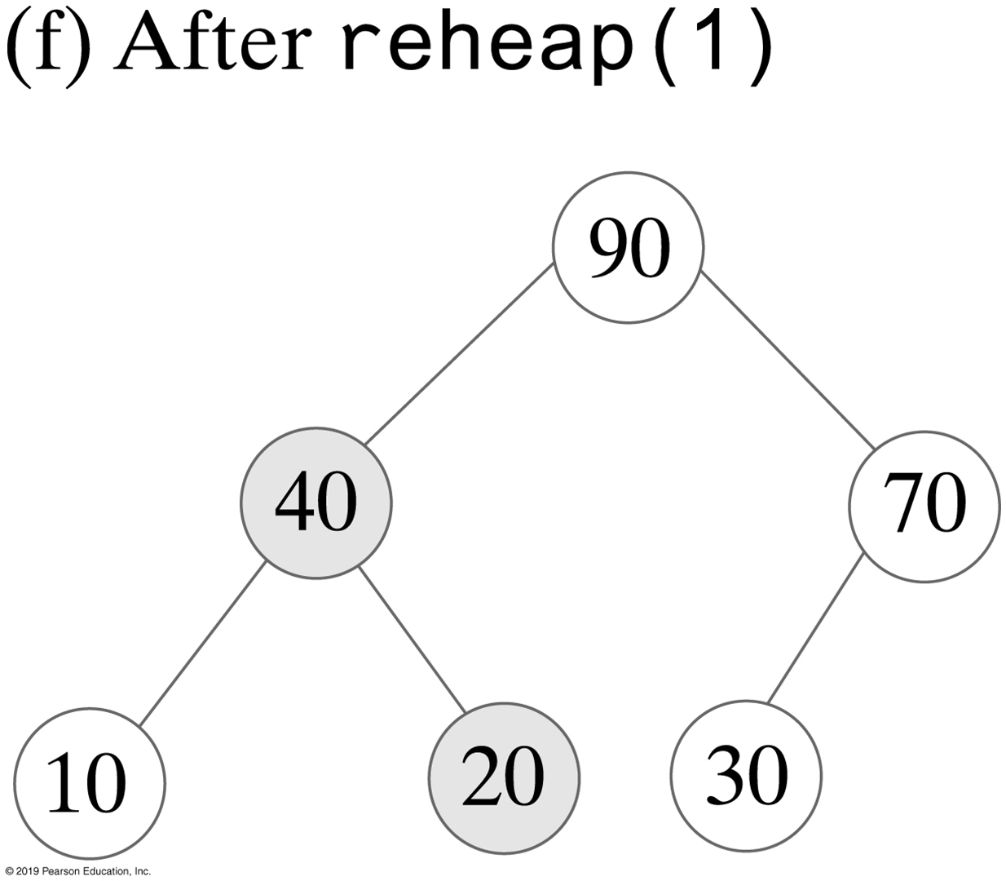
Creating a Heap
FIGURE 27-8 The steps in creating a heap of the entries 20, 40, 30, 10, 90, and 70 by using reheap

Slide 22
Creating a Heap
public MaxHeap(T[] entries)
{
this(entries.length); // Call other constructor
lastIndex = entries.length;
// Assertion: integrityOK = true
// Copy given array to data field
for (int index = 0; index < entries.length; index++)
heap[index + 1] = entries[index];
// Create heap
for (int rootIndex = lastIndex / 2; rootIndex > 0; rootIndex--)
reheap(rootIndex);
} // end constructor
Another constructor for the class MaxHeap

Slide 23
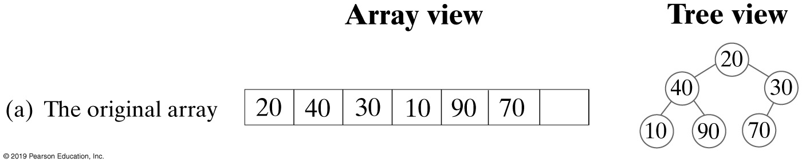
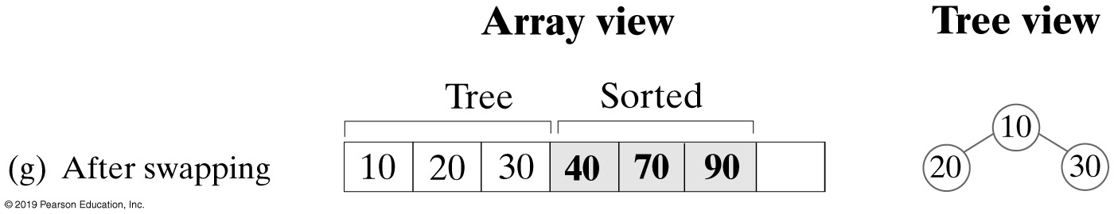
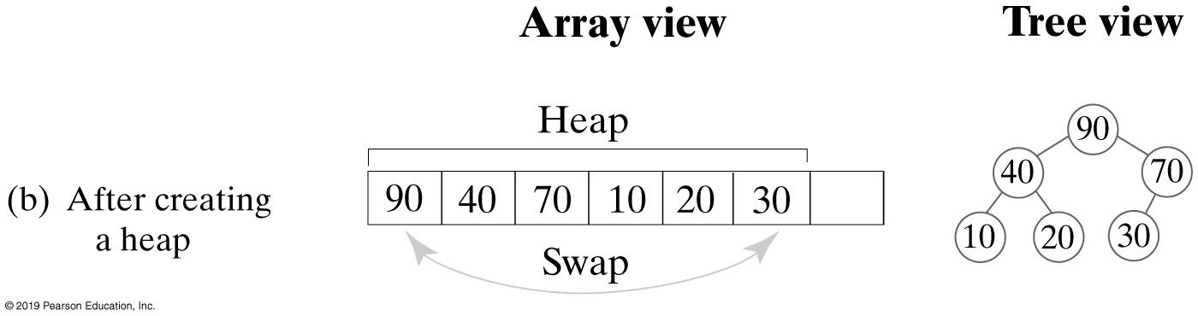
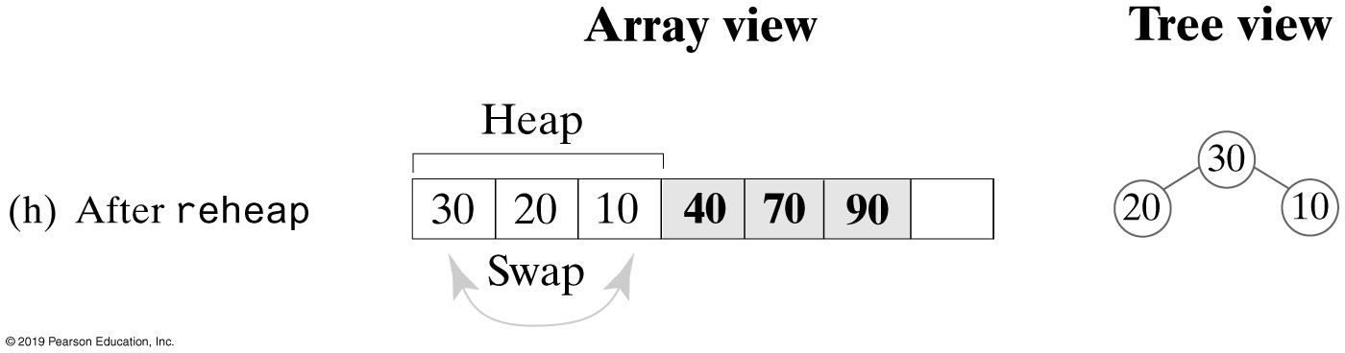
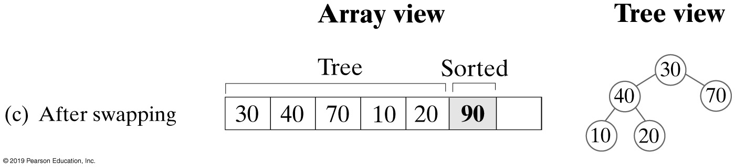
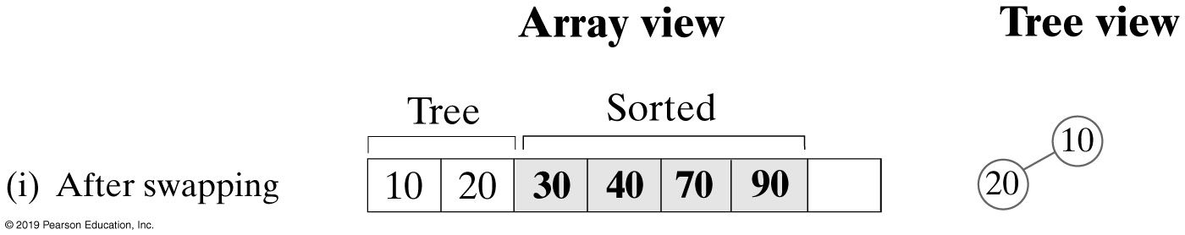
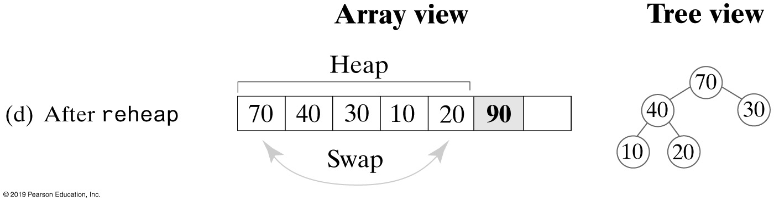
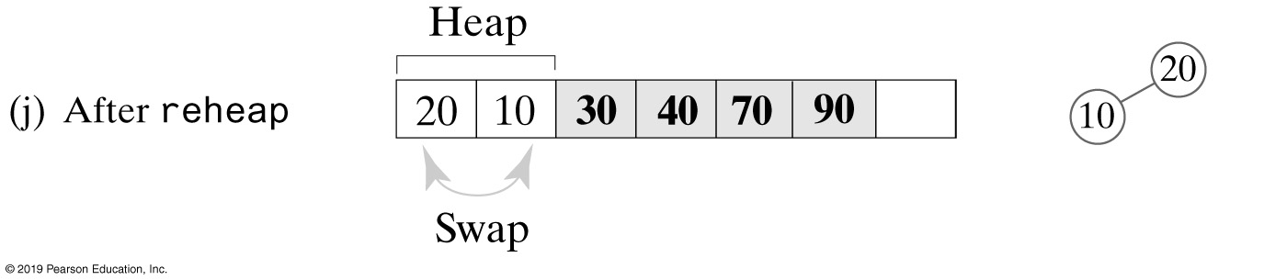
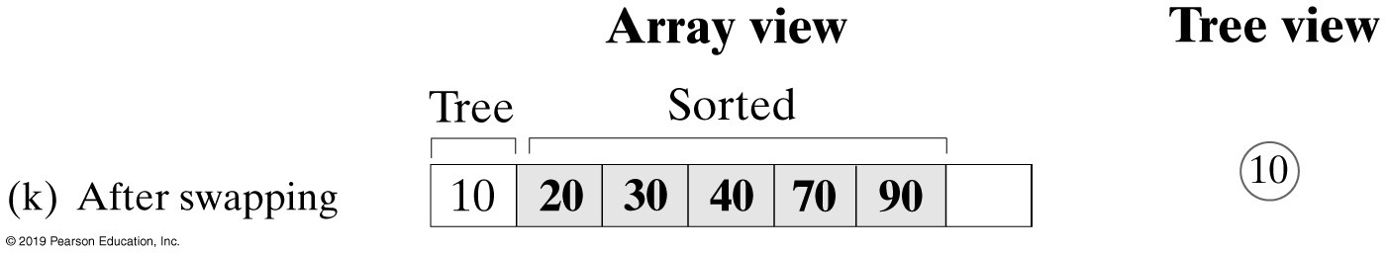
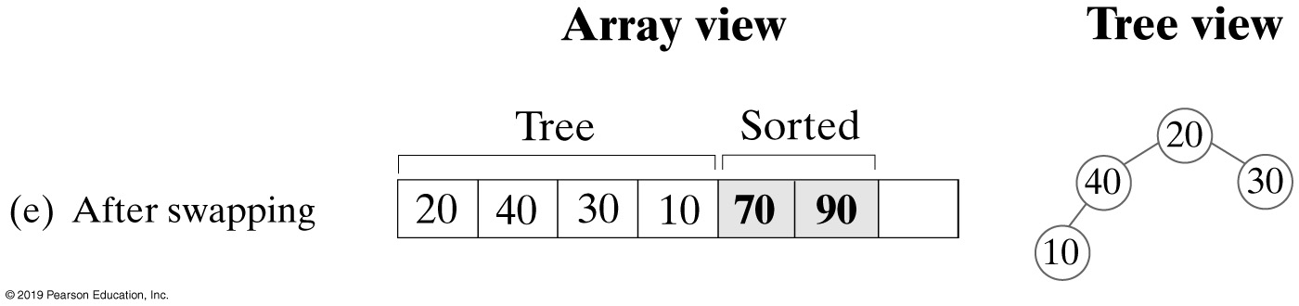
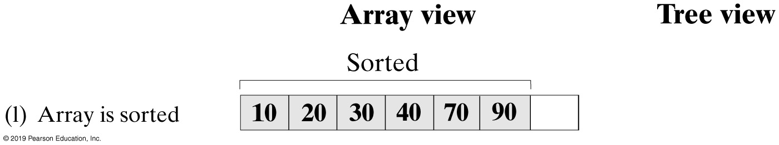
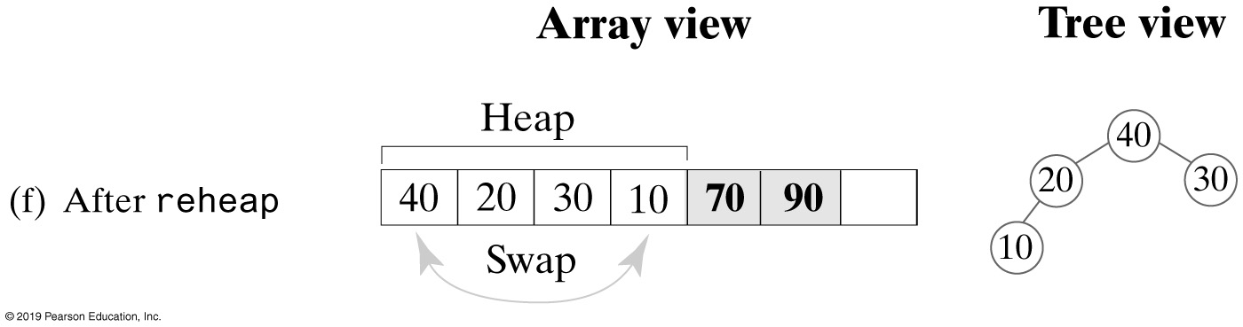
Heap Sort
FIGURE 27-9 A trace of heap sort

Slide 24
Heap Sort - Revised reheap Method
private static <T extends Comparable<? super T>>
void reheap(T[] heap, int rootIndex, int lastIndex)
{
boolean done = false;
T orphan = heap[rootIndex];
int leftChildIndex = 2 * rootIndex + 1;
while (!done && (leftChildIndex <= lastIndex))
{
int largerChildIndex = leftChildIndex;
int rightChildIndex = leftChildIndex + 1;
if ( (rightChildIndex <= lastIndex) &&
heap[rightChildIndex].compareTo(heap[largerChildIndex]) > 0)
{
largerChildIndex = rightChildIndex;
} // end if
if (orphan.compareTo(heap[largerChildIndex]) < 0)
{
heap[rootIndex] = heap[largerChildIndex];
rootIndex = largerChildIndex;
leftChildIndex = 2 * rootIndex + 1;
}
else
done = true;
} // end while
heap[rootIndex] = orphan;
} // end reheap

Slide 25
Heap Sort
public static <T extends Comparable<? super T>>
void heapSort(T[] array, int n)
{
// Create first heap
for (int rootIndex = n / 2 - 1; rootIndex >= 0; rootIndex--)
reheap(array, rootIndex, n - 1);
swap(array, 0, n - 1);
for (int lastIndex = n - 2; lastIndex > 0; lastIndex--)
{
reheap(array, 0, lastIndex);
swap(array, 0, lastIndex);
} // end for
} // end heapSort
The heapSort method with time efficiency is O(n log n)

Slide 26
Data Structures and Abstractions with Java™
5th Edition
Chapter 7
Queues, Deques, and Priority Queues

Slide 27
ADT Priority Queue
Consider how a hospital assigns a priority to each patient that overrides time at which patient arrived.
ADT priority queue organizes objects according to their priorities
Definition of “priority” depends on nature of the items in the queue

Slide 28
ADT Priority Queue
/** An interface for the ADT priority queue. */
public interface PriorityQueueInterface<T extends Comparable<? super T>>
{
/** Adds a new entry to this priority queue.
@param newEntry An object to be added. */
public void add(T newEntry);
/** Removes and returns the entry having the highest priority.
@return Either the object having the highest priority or, if the
priority queue is empty before the operation, null. */
public T remove();
/** Retrieves the entry having the highest priority.
@return Either the object having the highest priority or, if the
priority queue is empty, null. */
public T peek();
/** Detects whether this priority queue is empty.
@return True if the priority queue is empty, or false otherwise. */
public boolean isEmpty();
/** Gets the size of this priority queue.
@return The number of entries currently in the priority queue. */
public int getSize();
/** Removes all entries from this priority queue. */
public void clear();
} // end PriorityQueueInterface
LISTING 7-5 An interface for the ADT priority queue

Slide 29
Tracking Your Assignments
Assignment
course—the course code task—a description of the assignment date—the due date
getCourseCode() getTask() getDueDate() compareTo()
AssignmentLog
log—a priority queue of assignments
addProject(newAssignment) addProject(courseCode, task, dueDate) getNextProject() removeNextProject()
FIGURES 7-12 & 7-13 UML diagrams of the class Assignment and AssignmentLog

Slide 30
Tracking Your Assignments
public class AssignmentLog
{
private PriorityQueueInterface<Assignment> log;
public AssignmentLog()
{
log = new PriorityQueue<>();
} // end constructor
public void addProject(Assignment newAssignment)
{
log.add(newAssignment);
} // end addProject
public void addProject(String courseCode, String task, Date dueDate)
{
Assignment newAssignment = new Assignment(courseCode, task, dueDate);
addProject(newAssignment);
} // end addProject
public Assignment getNextProject()
{
return log.peek();
} // end getNextProject
public Assignment removeNextProject()
{
return log.remove();
} // end removeNextProject
} // end AssignmentLog
LISTING 7-6 The class AssignmentLog

Slide 31
Java Class Library: The Class PriorityQueue
Basic constructors and methods
PriorityQueue()
PriorityQueue(int initialCapacity)
add(T newEntry)–returns true or throw an exception
offer(T newEntry)- returns true or false
remove()
poll()
element()
peek()
isEmpty(), clear(), size()

Slide 32
Data Structures and Abstractions with Java™
5th Edition
Chapter 8
Queue, Deque, and Priority Queue Implementations

Slide 33
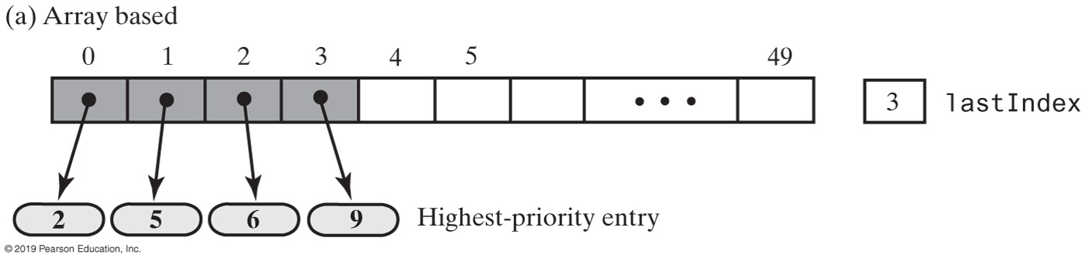
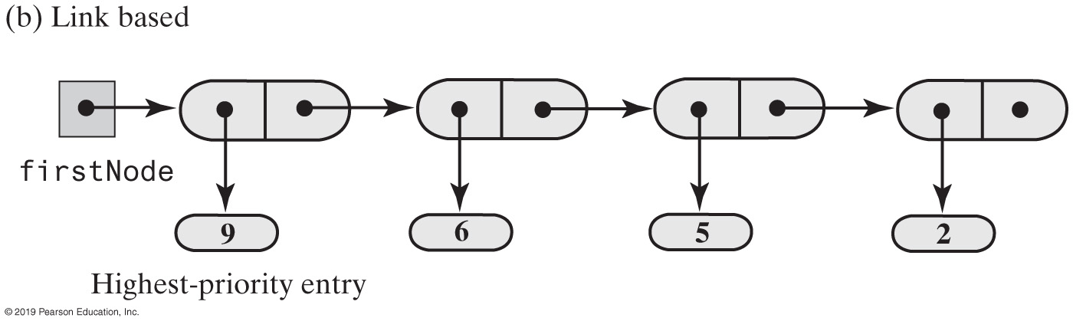
Possible Implementations of a Priority Queue
FIGURE 8-21 Two possible implementations of a priority queue

